Slide 1
HomeSec
Next-gen home security for all

Slide 2
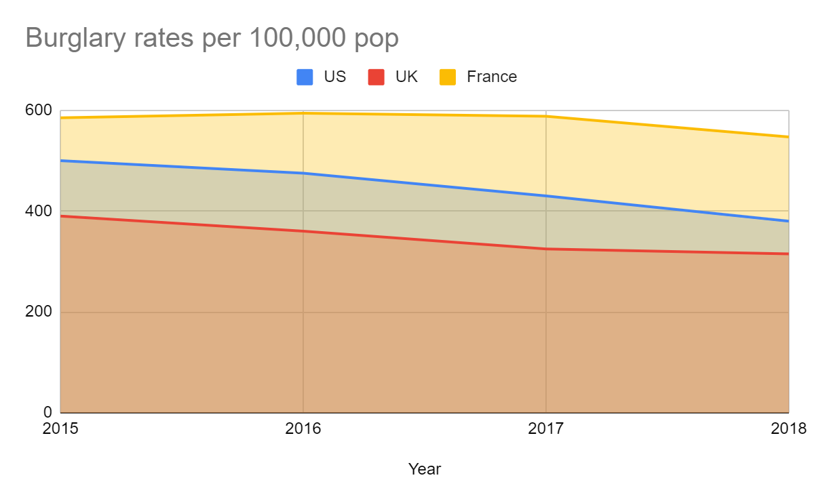
BACKGROUND
With the extraordinarily high rates of burglary in developed countries, HomeSec aims to act as a shield for the average homeowner with its advanced home security systems. HomeSec instantly detects intrusions, alerts the homeowner, and records video evidence of the burglary.
Data taken from Statista.

Slide 3
TARGET USERS
HomeSec targets homeowners who want a sense of security knowing that their house will not be broken into when going out. Due to the flexible placement of its sensor suites, HomeSec is able to target homeowners with all sorts of different home layouts.

Slide 4
FEATURES
Instant detection
Easy installs
Maintainance-friendly
24/7 surveillance
Foolproof
Shock detection
Alerts you the moment an intrudion happens
Just stick a sensor on and configure it in seconds
Automatically alerts you if battery is low or if a device becomes irresponsive
Check on your home anytime on your laptop, phone, or tablet
Reminds you if you forget to close a door or window
Detect forceful entry reliably with shock sensors

Slide 5
EXISTING PRODUCTS
Feature | HomeSec | SimpliSafe | ADT
Easy installation | ✅ | ✅ | ❌
User-friendly Interface | ✅ | ✅ | ✅
Cameras | ✅ | ✅ | ✅
Entry detection | ✅ | ✅ | ✅
Shock detection | ✅ | ❌ | ❌

Slide 6
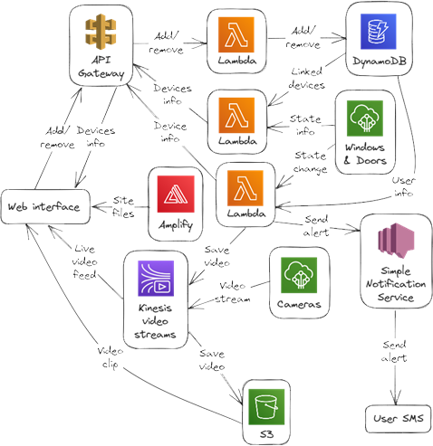
SYSTEM ARCHITECHTURE

Slide 7
ASSUMPTIONS
1
User installs the sensors firmly so that they don’t fall off easily
User remembers to update their phone number and email if needed
2
3
4
User always has internet connection to access their dashboard
The physical devices are extremely reliable

Slide 8
LIMITATIONS
Blackouts
Maintainance
HomeSec devices require an internet connection to report live
Users are required to periodically replace sensor batteries

Slide 9
FUTURE ENHANCEMENT
Dedicated network
Constant power
HomeSec can have it’s own dedicated network for devices to connect to so that they are not dependent on the user’s wi-fi
The devices can be plugged into a power source with a battery backup so that users never have to replace batteries

Slide 10
CHALLENGES/LESSONS LEARNT
- I wanted to make the addition of new devices to a user’s account as hands-free as possible, but I had difficulty in finding out how to get the information from the device to the cloud without the user typing it in themselves. After doing some research, I decided to use an “init” topic and some wildcards to get the information from the devices to the cloud. And by keeping track of the generated device ID, I also managed to make sure that only that new device could be added to the user’s account, preventing others from adding devices to an account without the user’s knowledge.

Slide 11
THANKS!

